Slide 1
1. UIN: 679850219
2. UIN: 672039068
3. UIN : 654324917

Slide 2
Segmentation of American people based on Demographics
Prepared for Mr. Client
13th March, 2017

Slide 3
Executive summary
This presentation is in response to ABC Inc. to execute a segmentation of American people based on demographics.
The results are based on data from 34,297 respondents.
Cluster analysis was used to identify the segments in the data.
The results show that there are 6 segments of American people based on demographics:
Family Households
Households with high affluence index
Rental households
Non-white households
Senior citizens
Middle class households.

Slide 4
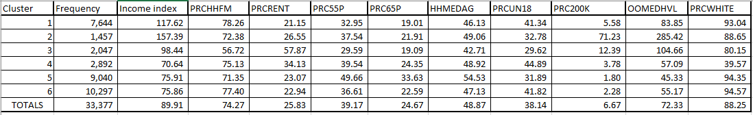
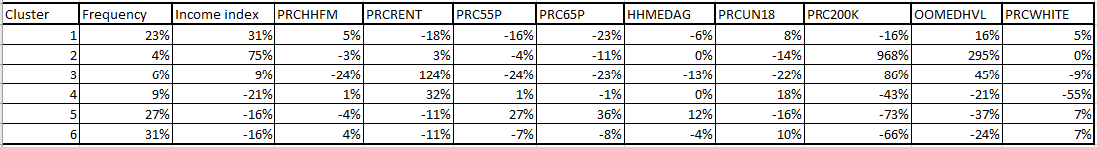
Summary Figures
Given below are a few variables which most efficiently describe the demographics of a person.
Table 1. Average responses of selected attributes for each segment and for the entire set of respondents.
Table 2. Summary measure of segment averages relative to the overall average.
In table 2. the percentages are a relative figure calculated for averages of each variable for each segment relative to the population average of the same variable for the whole U.S., which gives us a relative measure to differentiate between segments.
For example: The average PRCRENT (Percentage of housing units occupied by renters) for Rental Households segment (Segment 3) is 57.87 vs. 25.83 for the entire population. This translates into a relative measure of 124% in table 2. [(57.87-25.83)/25.83 = 1.24 (or) 124%]

Slide 5
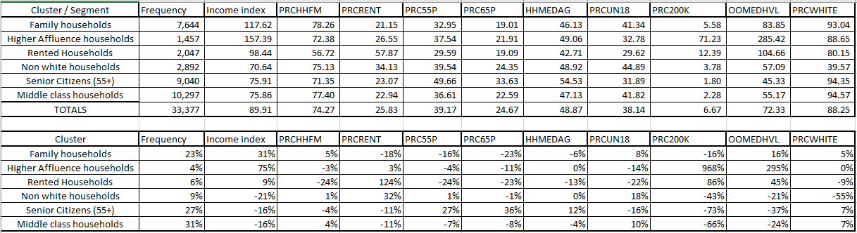
Well Off, Not Old
Figures relating to cluster 1 are shown in the table below. The relative percentages of Income Index, PRC55P (percent occupied housing units – age 55+) and PRC65P (percent occupied housing units – age 65+) are 31%, -16% and -23% respectively. These figures are closer to average and illustrate that this segment represents a significant portion of the American population who are above the middle age but not old. All the other segments have above or below average figures for these variables. As a result this segment was named ‘Well Off, Not Old’.
Table 3. Segment Statistics

Slide 6
Households with high affluence
Figures relating to cluster 2 are shown in the table below. The relative percentages of variables INCMINDX (Income Index), PRC200K (Percent OOH value $200000+) and OOMEDHVL (OOH census median home value in 1000s) are 75%, 968% and 295%. These figures are the highest for cluster 2 as compared to the other clusters implying that this cluster represents wealthy households of the American population with a high affluence index.
Table 4. Segment Statistics

Slide 7
Singles, No Kids, Rental Households
Figures relating to cluster 3 are shown in the table below. The relative percentage of PRCRENT (Percent occupied housing units – renter occupied) is 124% which is the highest for cluster 3 as compared to the other clusters implying that this cluster represents households of the American population which pay rents. Furthermore, Cluster 3 has below average relative percentages of -24% and -22% for the PRCHHFM (percent of households that are families) and PRCUN18 (percent households more than one under 18) variables respectively. These figures indicate that these households have that portion of American population who are single and have no kids. As a result this segment was named ‘Single, No Kids, Rental Households’.
Table 5. Segment Statistics

Slide 8
Non- white, Less Affluent households
Figures relating to cluster 4 are shown in the table below. The relative percentages of PRCWHITE (percent occupied households-white) and Income Index are -55% and -21% which are below average figures for cluster 4 as compared to the other clusters implying that this cluster represents households having non-white people from the American population with a relatively less affluence index. As such we named this segment Non-white, Less Affluent Households.
Table 6. Segment Statistics

Slide 9
Senior Citizens
Figures relating to cluster 5 are shown in the table below. The relative percentages of PRC55P (percent occupied housing units-age 55+) and PRC65P (percent occupied housing units-age 65+) are 27% and 36% which are above average figures and the highest for cluster 4 as compared to the other clusters which implies that this cluster represents households which have American people above the age of 55+. So, this segment was named Senior Citizens.
Table 7. Segment Statistics

Slide 10
Middle America Households
Figures relating to cluster 6 are shown in the table below. The relative percentage of INCMINDX (Income Index), PRC200K (Percent OOH value $ 200000+) and OOMEDHVL (OOH census median home value in 1000s) are -16%, -66% and -24% which are below average figures for cluster 6 as compared to the other clusters which implies that this cluster represents the middle-class households of the American population.
Table 8. Segment Statistics

Slide 11
Summary
Results of cluster analysis based on 34,297 survey responses showed 6 segments of American people based on demographics.
Family households
Households with high affluence
Rental households
Non-white households
Senior citizens
Middle class households
Technical details regarding the cluster analysis are contained in the appendix.

Slide 12
Technical Appendix

Slide 13
Methods
The previous analysis was executed using k-means clustering analysis.
Hierarchical cluster analysis was not used because it is used on small datasets and our dataset consisted on 34,297 observations which is a significantly large number.
The inputs to cluster analysis were the 5 factors ( Factor 1, Factor 2, Factor 3, Factor 4 and Factor 5) generated using factor analysis method.
These were chosen over the original variables because of the presence of correlation between the original variables could skew our results. Hence, the original variables were converted into non-correlated factors using factor analysis.

Slide 14
Multiple iterations
The K-means clustering was executed 10 times for number of cluster 4 through 8.
Each iteration had a unique random starting point.
Two important metrics for selecting the correct number of clusters are pseudo f-statistic and size of smallest cluster. This is because greater pseudo f-statistic is an indicators of greater cluster discrimination and large changes in smaller cluster sizes are indicators of less cluster stability.

Slide 15
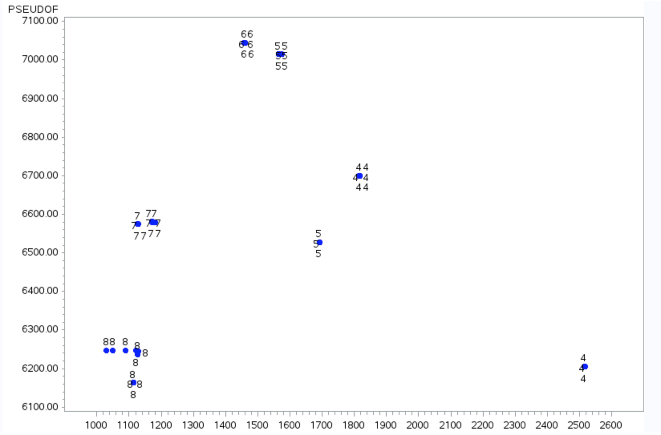
Pseudo F by size of smallest cluster
Graph 1: Pseudo F by size of smallest cluster
The graph at the left shows the pseudo f-statistic and size of smallest cluster for each of the 10 iterations from segment 4 through 8.
We eliminate segments 7 and 8 solutions because they had inferior discrimination as demonstrated by their lower pseudo f-statistic.
We can also eliminate the segment 4 solution because of inferior stability as demonstrated by the variation in the pseudo f-statistic and the size of smallest cluster which shows that many zip codes are changing clusters with each iteration, and also the discrimination between clusters varies from iteration to iteration.
The segment 5 and 6 cluster solutions are examined in more detail on the next slide.

Slide 16
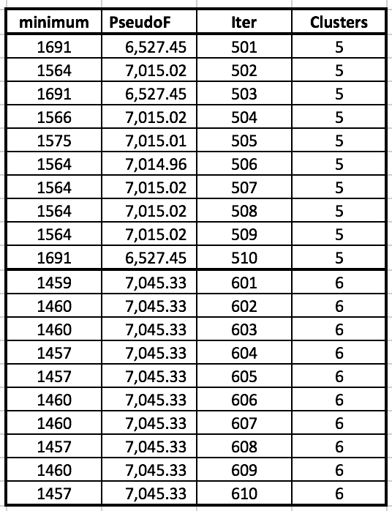
Discrimination analysis of clusters 5 and 6
Table 10: Pseudo F statistic and Size of Smallest cluster for the 10 iterations of cluster 5 and 6
The table on the left shows the figures for the pseudo f-statistic and the size of the smallest cluster for the 5 & 6 segment solutions.
The segment 6 solution has higher pseudo f-scores vs. the segment 5 solution.
Based on the magnitude of the pseudo f-statistic, the segment 6 solution has a greater discrimination vs. the segment 5 solution.

Slide 17
Stability analysis of 5 and 6
Table 10: Pseudo F statistic and Size of Smallest cluster for the 10 iterations of cluster 5 and 6
CLUSTER 5
Average Pseudo F-statistic
= ((3*6527.45)+(6*7015.02)+7014.96)/10
=6,868.74
CLUSTER 6
Average Pseudo F-statistic
=10*7045.33/10
=7,045.33
Cluster 6 has a consistent and larger Pseudo F-statistic for the 10 iterations as compared to cluster 5. Cluster 5 shows a 3/7 split consistency in the pseudo F-statistic. Based on the consistency in the pseudo F-statistic, Cluster 6 has a greater stability as compared to Cluster 5.

Slide 18
Stability analysis of 5 and 6
Table 10: Pseudo F statistic and Size of Smallest cluster for the 10 iterations of cluster 5 and 6
CLUSTER 5
Largest size of smallest cluster: 1,691
Smallest size of smallest cluster: 1,564
Difference: 1691-1564 = 127
CLUSTER 6
Largest size of smallest cluster: 1,460
Smallest size of smallest cluster: 1,457
Difference: 1460-1457 = 3
From the differences calculated above, Cluster 6 illustrates that for every iteration, a maximum of 3 zip codes change cluster membership as compared to 127 for Cluster 5.
Based on size of smallest cluster, Cluster 6 has greater stability as compared to Cluster 5.

Slide 19
Detailed analysis of 5 and 6
Table 10: Pseudo F statistic and Size of Smallest cluster for the 10 iterations of cluster 5 and 6
From the calculations shown in the previous 2 slides, cluster 6 shows a superior discrimination as compared to cluster 5 based on the average pseudo F-statistic figures, along with a superior stability as compared to cluster 5 based on the consistency of the Pseudo f-statistic figures and the differences in the size of smallest cluster.
Therefore, we can conclude that 6 is an optimal number of clusters to be chosen.

Slide 20
Group Members
Adusumelli, Jaideep (UIN: 672039068)
Ganesh, Laavanya (UIN : 654324917)
Otwani, Harsh (UIN: 679850219)

